Slide 1
Maritime & Logistics Career Opportunities

Slide 2
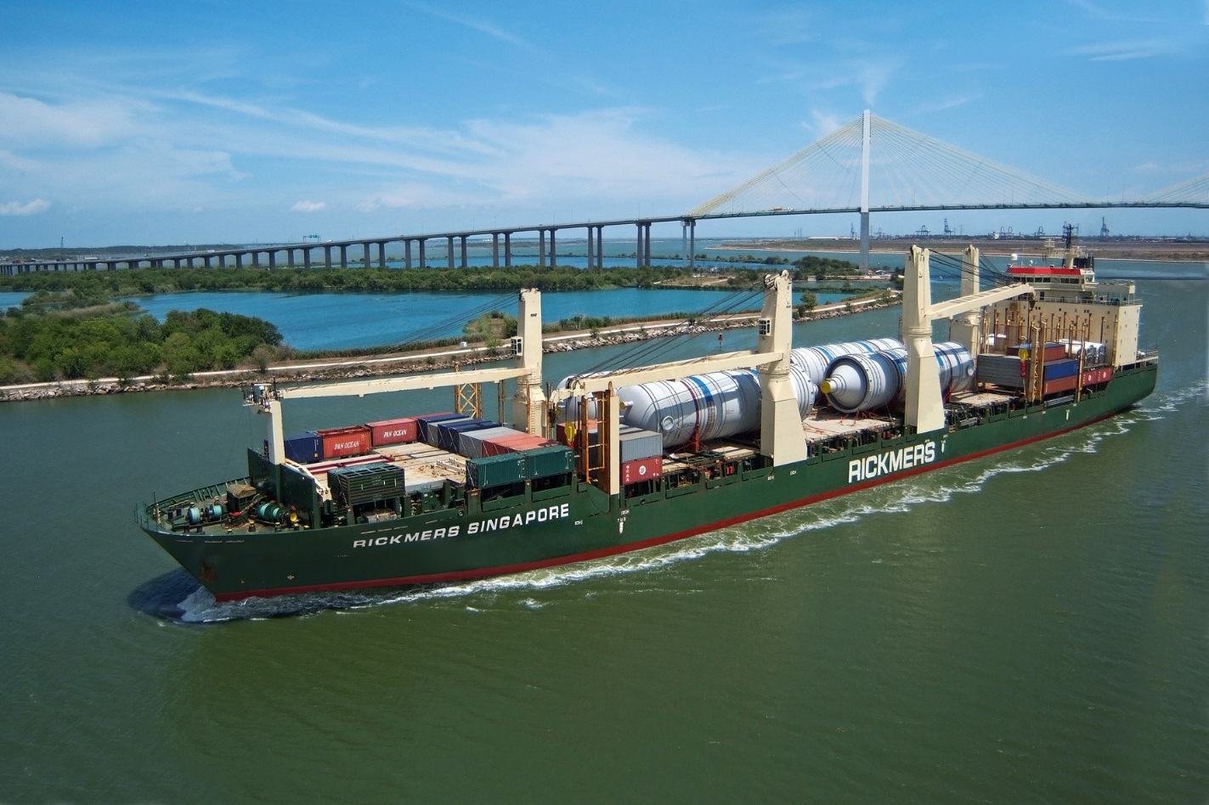
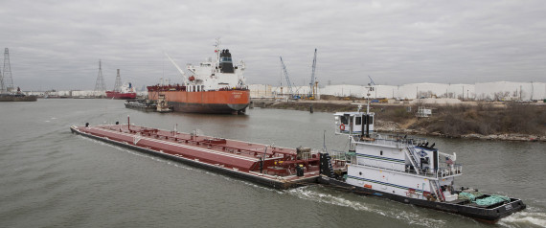
What is THE Maritime Industry?
Have you seen the ships and barges traveling on the Houston Ship Channel?

Slide 3
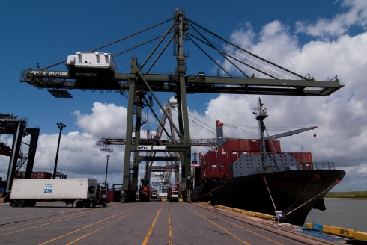
HOUSTON MARITIME
Houston’s Maritime Industry includes all of the companies that own, operate, service and support the transport of goods on ships and barges

Slide 4
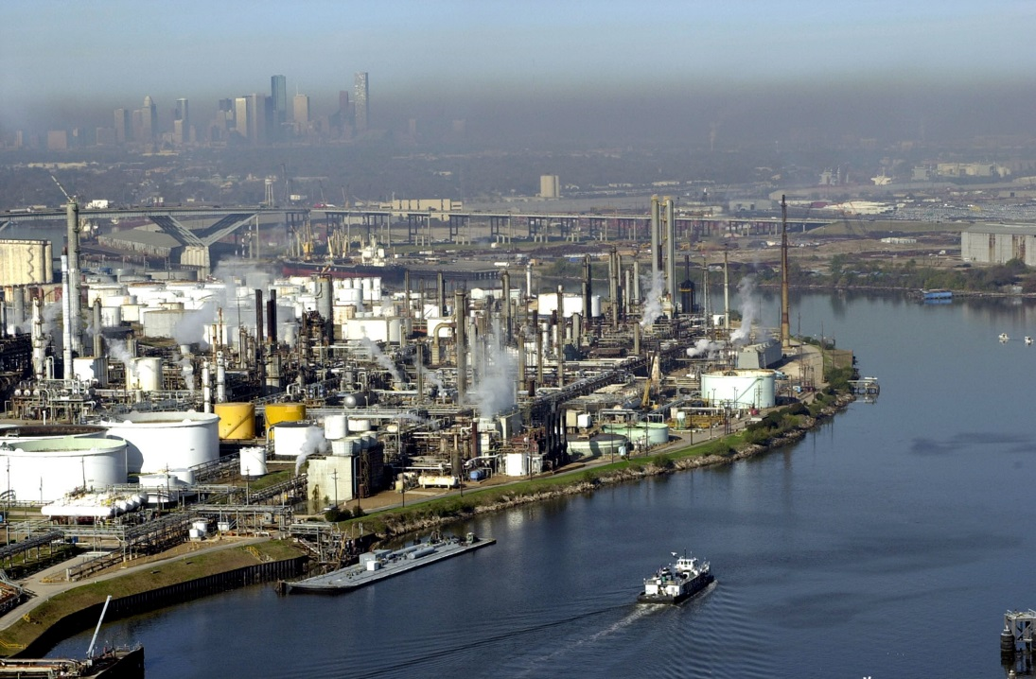
THE INDUSTRY IS GROWING
The growth of maritime cargo in Houston has been strong and steady:
1st ranked US port in foreign tonnage
2nd ranked US port in total tonnage
6th ranked US container port by total TEUs in 2014
Largest Texas port with 46% of market share by tonnage and 95% market share in containers by total TEUS in 2014
HOUSTON IS THE CENTER OF THE ENERGY INDUSTRY

Slide 5
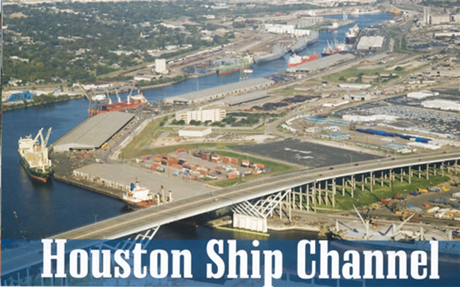
HOW MUCH Houston CARGO IN 2012?
Houston Cargo Rising
238 million tons
Ship & Barge Calls (Visits)
5400+ Tankers
1000+ Container Ships
880 Bulk
250+ LNG/LPG
200 Ro-Ro
580 General Cargo
200,000+ Barges

Slide 6
Maritime & logistics - imports

Slide 7
HOW MUCH CARGO
Houston Cargo Rising
2012 – 238 million tons
2011 – 230 million tons
2010 - 206 million tons

